Slide 1
HACKTOBERFEST 26
IEI STUDENTS’ CHAPTER CSE
Team name: Cicadas303
Skill-Swap: Open-source, AI-matched peer-to-peer skill trading platform.
Built with Node.js, HTML, CSS and the Gemma 4 API

Slide 2
Teach one skill, learn another
You teach
You learn
↔
python
english
photography
ux design
Skill-Swap pairs people whose goals line up and helps them trade lessons.

Slide 3
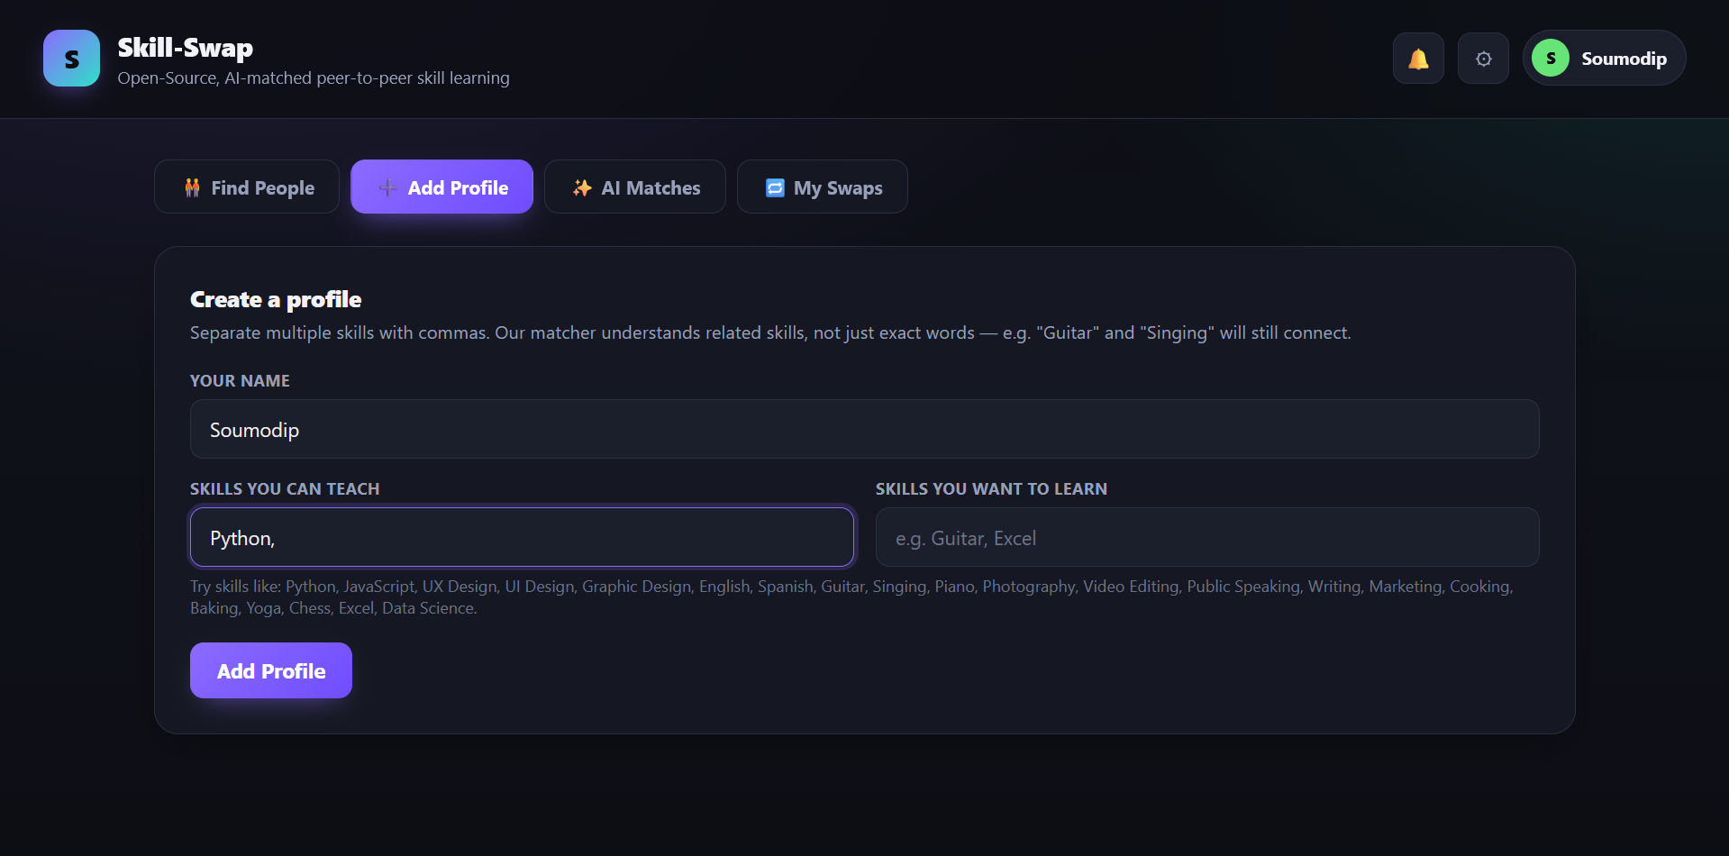
Create a profile
List the skills you can teach and the ones you want to learn.
Separate skills with commas.
Adding your own name again updates your profile instead of duplicating it.

Slide 4
Smarter skill matching
Gemma 4 live scoring
Skill pair | Score
Photography / Photography | 1.0
Python / Data Science | 0.6
UX Design / Graphic Design | 0.6
English / Spanish | 0, blocked
Rates how related two skills are, through the Gemini API.
Offline fallback
A local relation graph takes over if the call fails or is turned off.
Strict rules
Pairs under 0.5 are dropped, different languages never match, and you never match yourself.
Examples from the local engine. Gemma 4 scores pairs live.

Slide 5
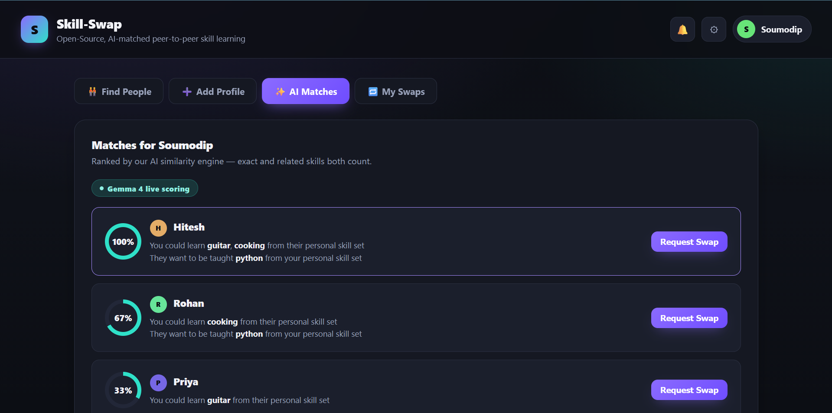
Ranked matches
A percentage score ranks every match.
Plain lines show what each side gains.
Your own profile never appears in the list.

Slide 6
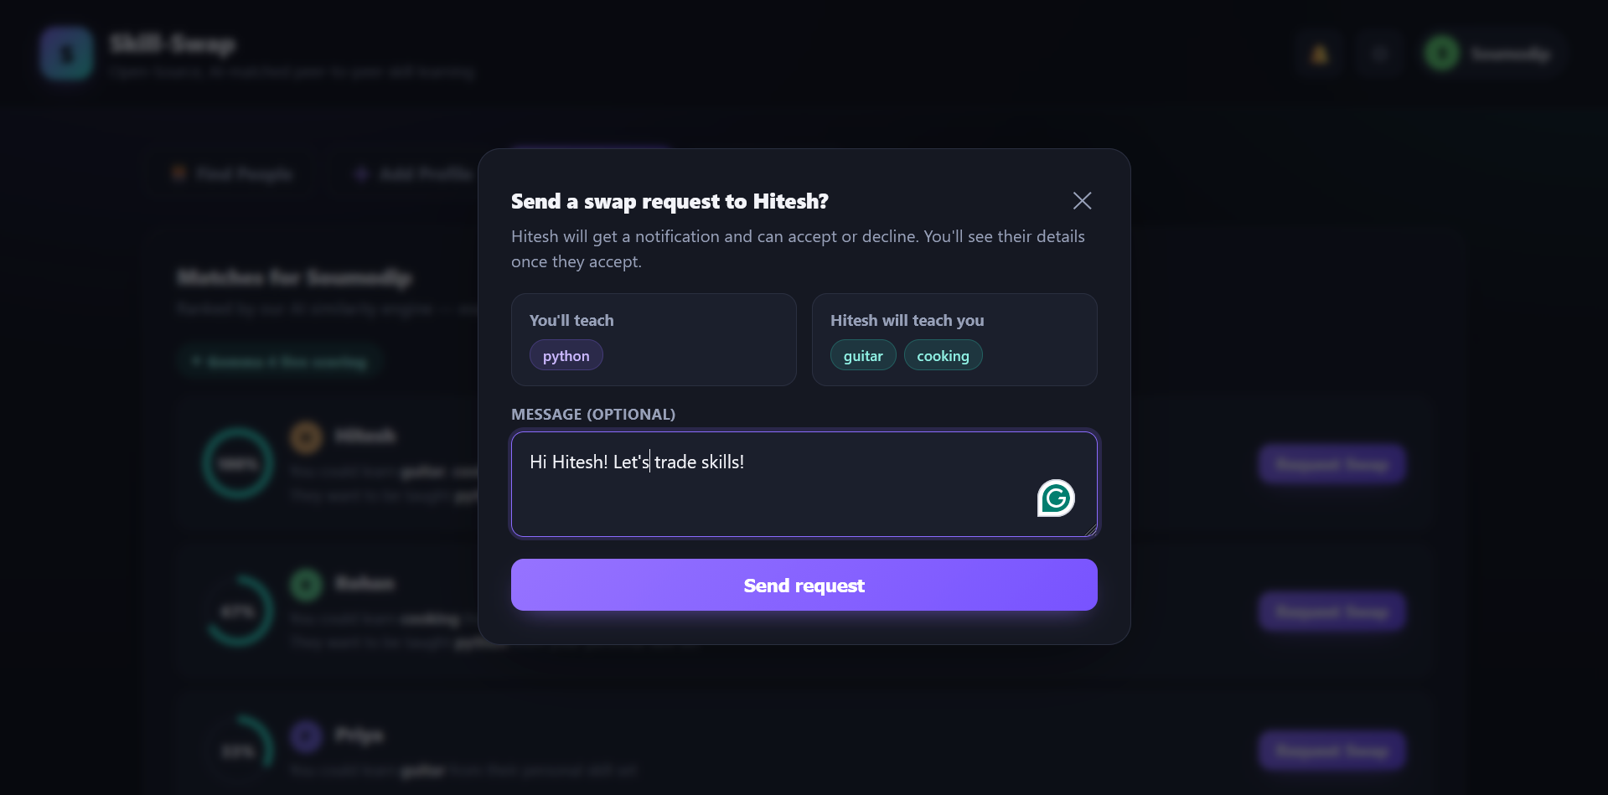
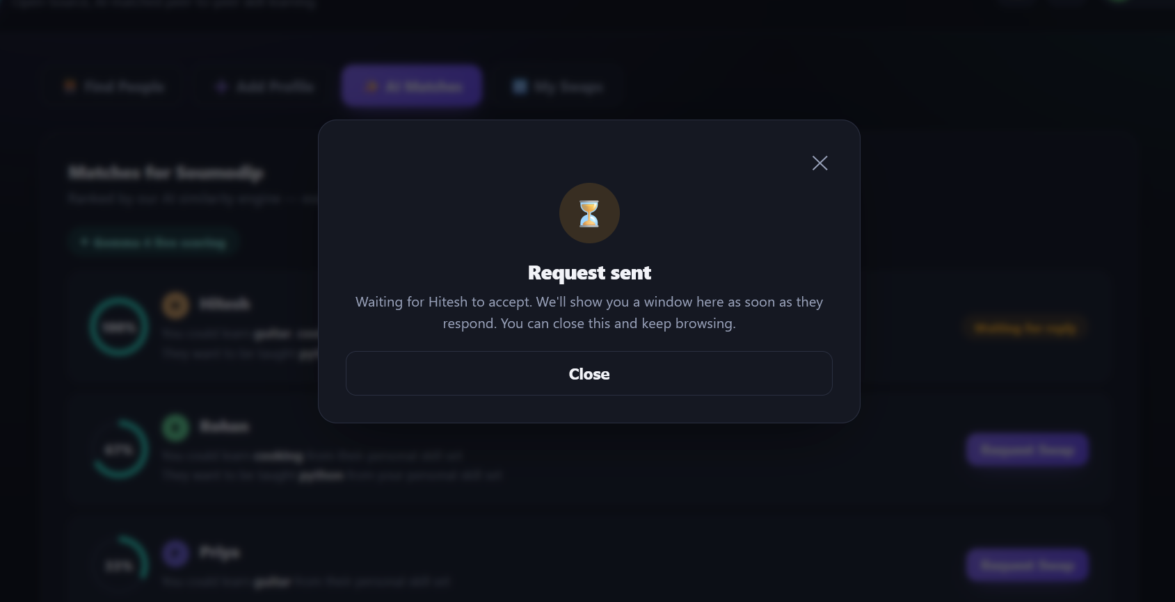
Send a swap request
Review the skills on both sides and add a message.
A waiting window shows until the other person responds.

Slide 7
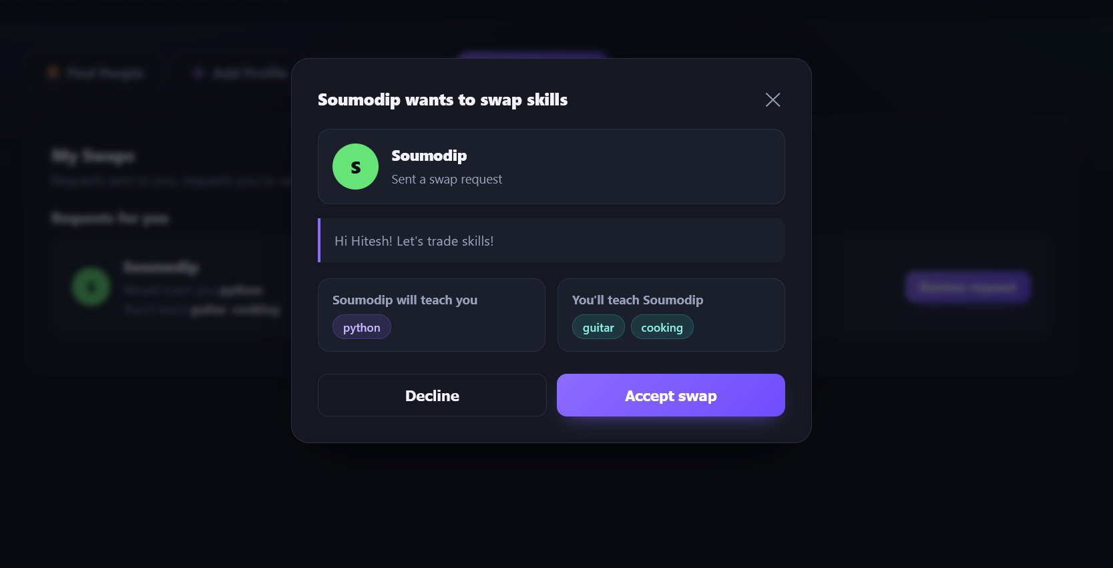
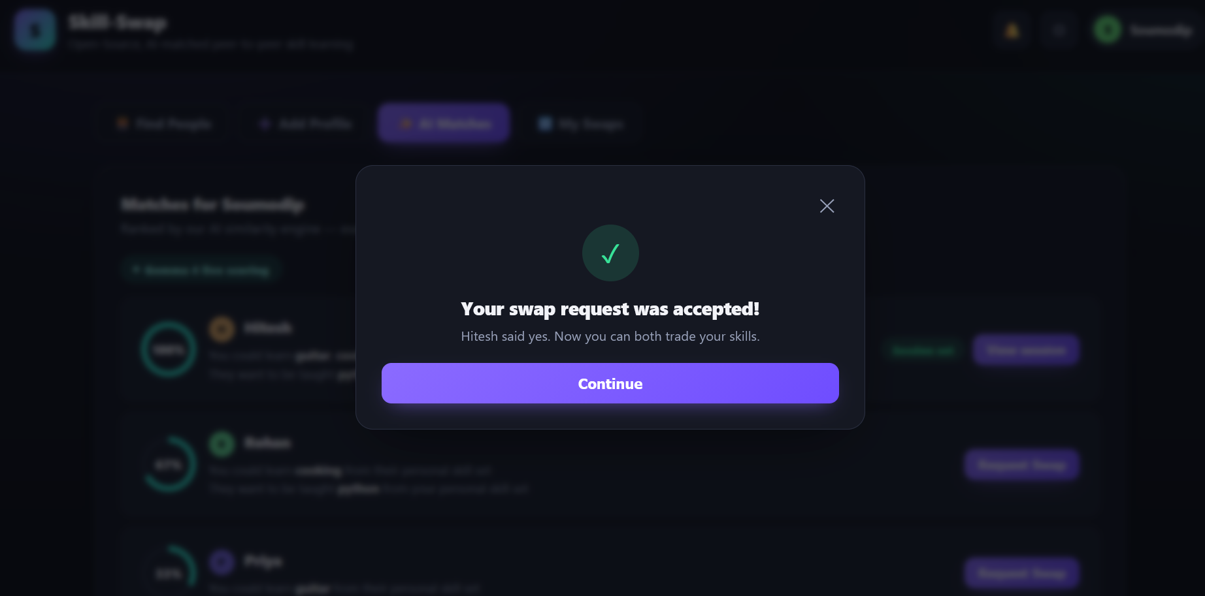
Review and accept
The other person sees your message and the skills on both sides, then accepts or declines.
You get this confirmation as soon as they accept. Contact details stay hidden until then.

Slide 8
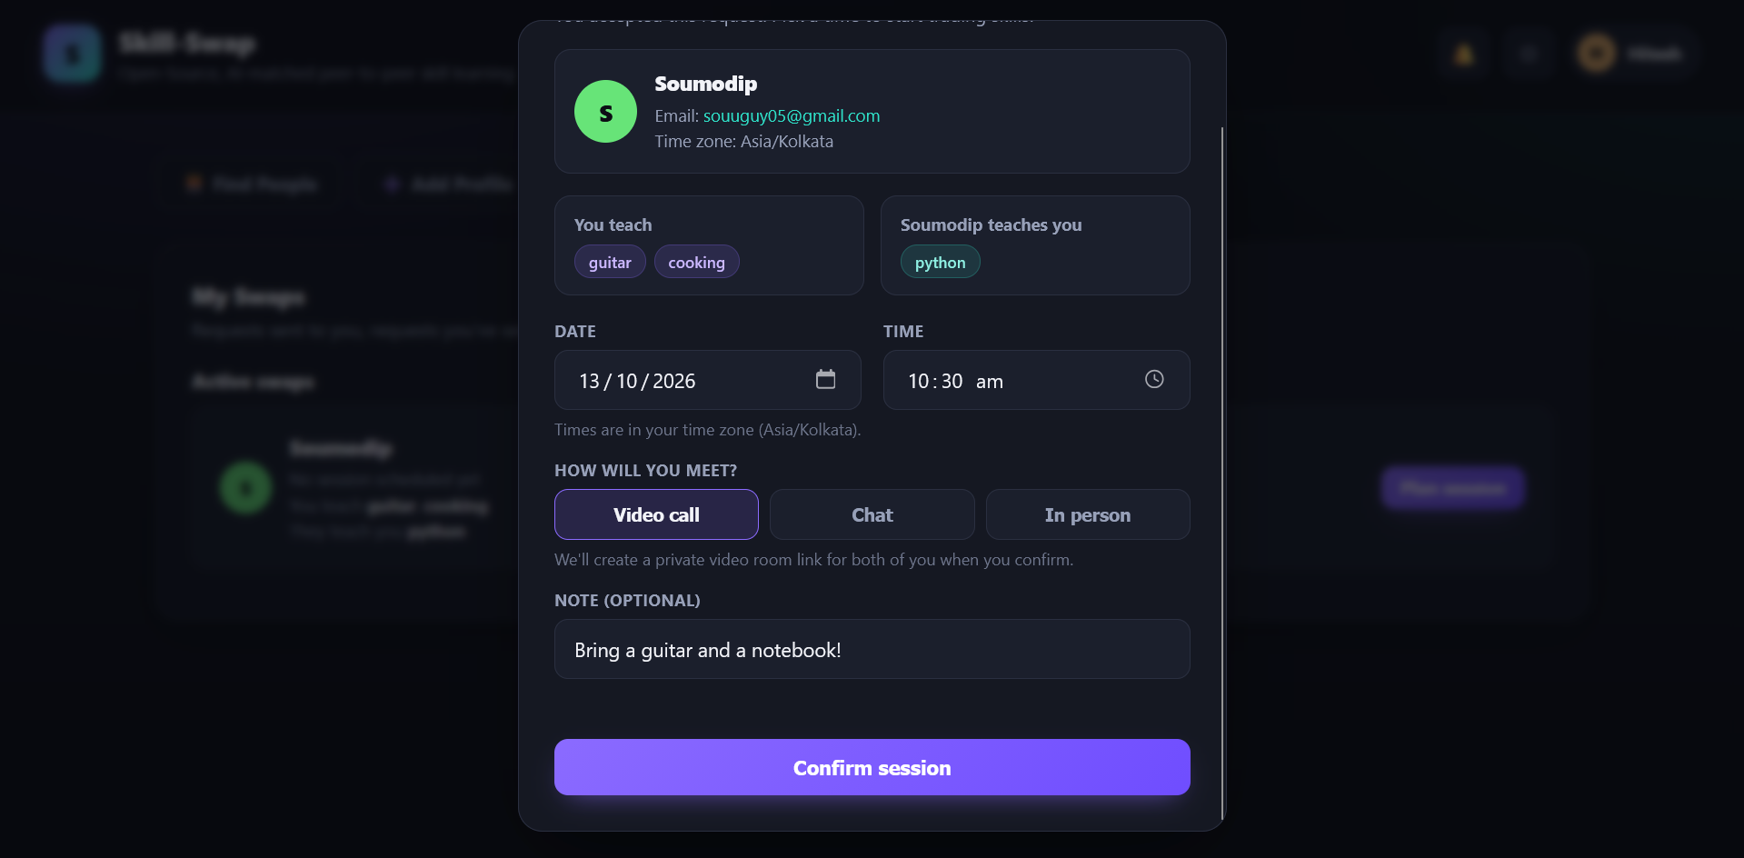
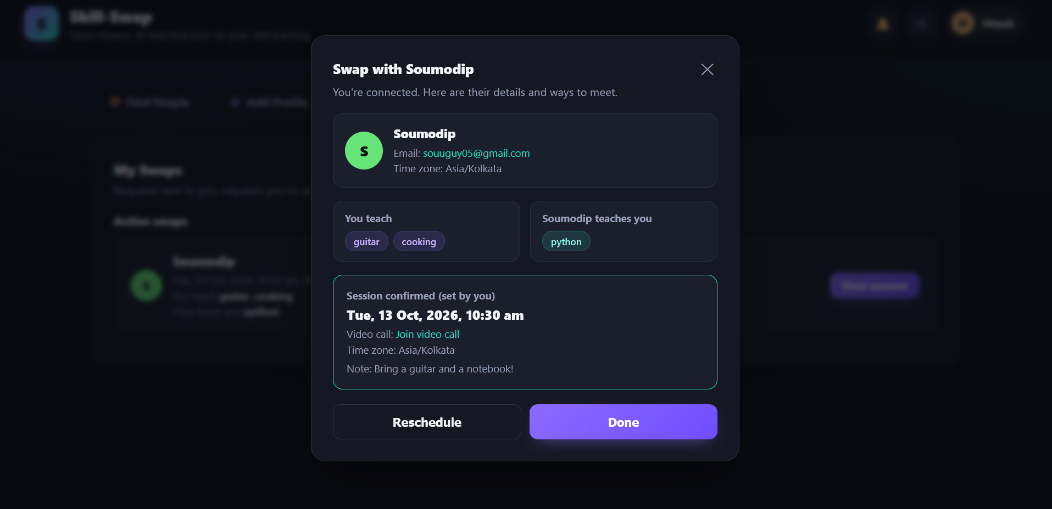
Plan the session
Pick a date and time, then video call, chat, or in person.
Once confirmed, the session shows on both schedules.

Slide 9
How it's built
Node.js
HTML + CSS
Gemma 4 API
Backend runtime for the project.
Dark single-page interface with live match cards.
Semantic skill scoring through the Gemini API, with a local fallback.
Demo state (profiles, requests, sessions) is kept in the browser's localStorage, so you can run the full flow by logging in as two people in two tabs.

Slide 10
Next steps
Enforce swaps on the server
Move requests to Node.js endpoints so contact details are only released after acceptance.
Verify sign-in
Confirm email addresses before a profile goes live.
Add ratings
Let partners rate each session to build trust.
GitHub Link: https://github.com/soumodipbhatta33-source/SkillSwap

